Slide 1
Operators

Slide 2
Operators
Operators are used in programs to manipulate data and variables. Java operators can be classified into a number of related categories as below:
Arithmetic Operators
Relational Operators
Logical Operators
Assignment Operators
Increment and Decrement Operators
Conditional Operators
Bitwise Operators
Special Operators

Slide 3
Control Constructs

Slide 4
Control Constructs
SELECTION STATEMENT
ITERATION STATEMENT
JUMP STATEMENT
Selection Statement:
It allow to choose the set-of-instructions for execution depending upon an expression’s truth value.
Two types :
1. if statement
2. switch statement

Slide 5
Control Constructs
IF Statement:
It tests a particular condition.
Syntax
if(condition checking expression)
{
Statement for true condition;
}
If-else Statement: the else part gets executed if the condition of if statement evaluates false.

Slide 6
Control Constructs
if(condition checking expression)
{
statement for true condition;
}
else
{
statement for false condition;
}
If –else-If statement:
1. It used to tests condition at multiple level.
2. Syntax:

Slide 7
Control Constructs
if(condition expression) Level1
{
statement for true condition;
}
else if(condition expression) Level2
{
statement for true condition of else-if ;
}
else if(condition expression) Level3
{
statement for true condition of else-if ;
}
else
{
statement for false condition of all if;
}

Slide 8
Control Constructs
Nested If Statement:
A nested if is an if that has another if in its if’s body or else’s body or both.
Syntax:
if(condition expression)
{
if(expression){
Statement1;}
else{ statement2;}
}
else{
if(expression){
Statement1;}
else{ statement2;}
}

Slide 9
Iteration/Loop Statement
Loop: used for repetition of same task.
Loop consists of three part:
1. Initialization exp: used to began loop , it executed only once.
2. Test/Condition exp: its truth value decides whether the loop body will be executed or not.
3. Update exp: It change the value of loop variable. It executed at the end of loop after the loop-body is executed.
4. The Body-of -the-loop: contains statement of loop

Slide 10
Types of Loop
for – Loop
while- Loop
do-while – Loop
For- Loop: It initialize first, then test the condition, then execute statement from body of loop , and then execute update expression.
Syntax:
for(Initialization exp; Test exp; Update exp)
{
Body of loop
Statements
}

Slide 11
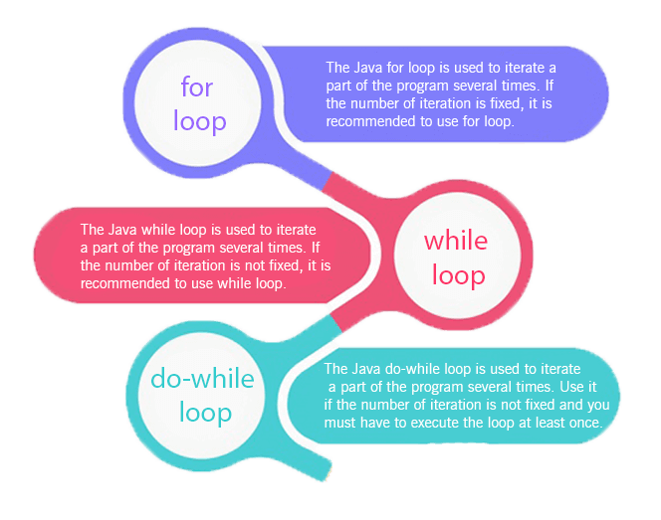

Slide 12
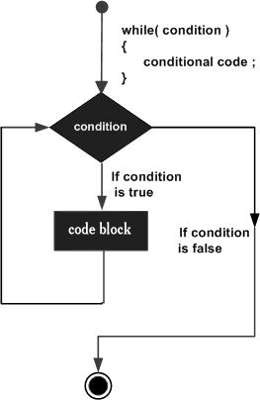
while(Boolean_expression)
{
// Statements
}

Slide 13
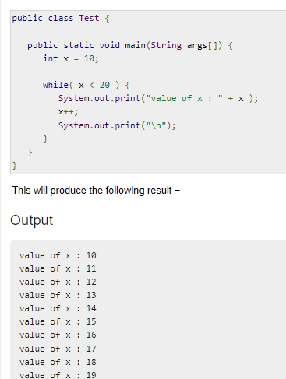

Slide 14
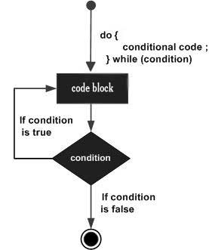
do
{
// Statements
}while(Boolean_expression);

Slide 15
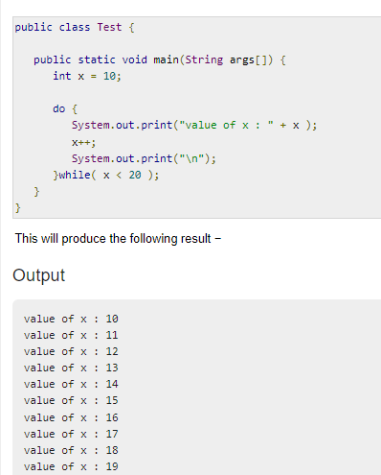

Slide 16
The syntax of a for loop is −
for(initialization; Boolean_expression; update)
{
// Statements
}

Slide 17
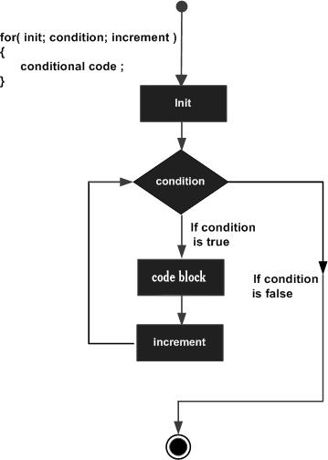

Slide 18
Nested-for-Loop
Syntax:
for(Initialization exp; Test exp; Update exp)
{
Body of outer for loop
for(Initialization exp; Test exp; Update exp)
{
Body of inner for loop
Statements
}
}

Slide 19
While Loop
It tests the condition , then execute the statement , and then execute update expression.
Syntax:
while(test exp)
{
Statements
Body of loop
Update expression
}

Slide 20
Do-while Loop
It executes the statements then executes update expression, and then test the condition. It executes statements for one time false condition.
Syntax:
do{
Statements
Body of Loop
Update expression
}while(test expression);

Slide 21
Jump Statement
Jump statements unconditionally transfer program control within a function. Java has three Jump statement:
return
break
continue

